Slide 1





Currency Converter
An Interactive Web Application

Slide 2

TEAM
Overview
Teams
Updates
Scope
Risks and Alternatives
Status
Timeline
Project Monitoring
Whiteboard Page
Budget
Roadmap
Brainstorm Page

Slide 3


What is a Currency Converter?
A currency converter is a tool that enables the conversion of one currency to another based on current exchange rates. It is widely used for international trade, travel, and financial transactions.
OBJECTIVES
GOALS
To create a responsive web application for currency conversion.
To utilize HTML for structure, CSS for styling, and JavaScript for functionality.
List the objective here
List the objective here
List the objective here

Slide 4
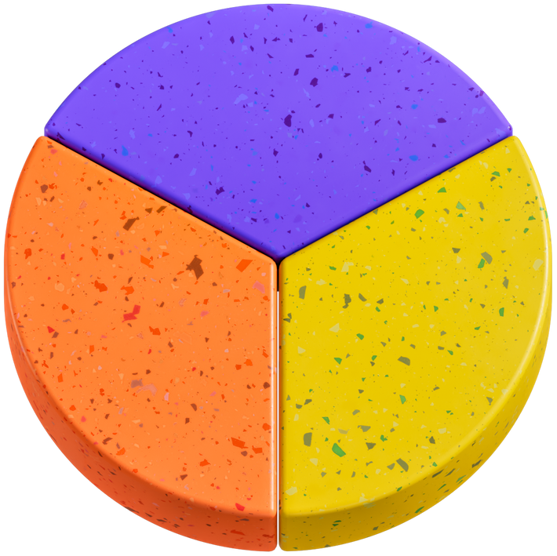
How Does Currency Conversion Work?
Currency conversion involves multiplying the amount in the original currency by the current exchange rate to determine the equivalent amount in the target currency.

Slide 5



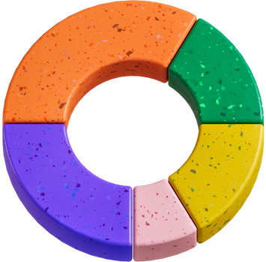
Scope
International Trade
Banking and Financial Institutions
E-commerce and Online Transactions
Education and Awareness

Slide 6



Tasks | Status
Java Script
CSS
HTML
In Progress
Blocked
Finished
Technologies Used
• HTML: Structure of the web application.
• CSS: Styling for a visually appealing interface.
• JavaScript: Logic for currency conversion and API integration.

Slide 7
HTML Implementation
Inputs fields for amount.
A select tag for currency selection.
A Button to trigger the conversion.
A Display Area for RESULTS.
ALTERNATIVES
Write an item here.
Write an item here.
Write an item here.

Slide 8
Css Styling
Code snippet
Responsive design Using Flexbox
Write an item here.
Colour scheme and fonts for better user experience.
Write an item here.
Write an item here.

Slide 9
JavaScripts
Functionlity
Code snippet
Fetching exchange rates from an API
Calculating converted amounts
Write an item here.
Write an item here.
Write an item here.

Slide 10
Challenges
ALTERNATIVES
Handling asynchronous API calls.
Ensuring accurate conversion rates
Responsive design issues.
Write an item here.
Write an item here.
Write an item here.

Slide 11



Status
Project Phase 1
Project Phase 2
Project Phase 3
60% done
70% done
80% done
Last updated:
Last updated:
Last updated:
January 10, 2025
January 10, 2025
January 10, 2025

Slide 12

For questions, reach out to:
Rima Das
rima983131@gmail.com
Co-worker
Sahali Das
sendtosahalidas@gmail.com
Co-worker
Sanjita Ray
Co-worker
sanjitaray62@gmail.com

Slide 13
Thank You
For your attention

